Slide 1
A web GIS application for integration of socio-economic, biophysical and atmospheric variables: A case study of Punjab province
Presented by:
Syed Mustafa Haider and Akram Ali shah
Department:
Space Science
Batch:
5

Slide 2
Content
Introduction to the Project
Literature Review
Objectives
Study Area
Methodology
Expected Outcome
Project TimeLine
References for Figures

Slide 3

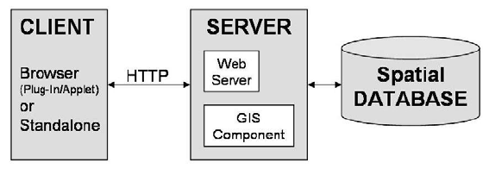
Introduction to the Project:
This study aims at development of a geospatial web application to facilitate data analysis and presentation.
A web application is a simple client-server program that is stored on a remote server and delivered over the internet through a browser interface. They can be designed to be used by variety of different people , organizations etc.
The Web GIS application would be in the form of a Geospatial web Portal ,which in simpler terms is a website where geospatial content is discoverable.
One Example is The Disaster watch which is a Geospatial web portal created by Sacred SUPARCO.

Slide 4
Literature Review
FEATURES | L. Liu, D. Li, and Z. Shao, “Design and implementation of a geospatial portal,” in Geoinformatics 2008 and Joint Conference on GIS and Built Environment: Geo-Simulation and Virtual GIS Environments, 2008, vol. 7143, no. August 2015, p. 71432E | H.Lin et al., “A geospatial web portal for sharing and analyzing greenhouse gas data derived from satellite remote sensing images,” Front. Earth Sci., vol. 7, no. 3, pp. 295–309, 2013 | R. Olyazadeh, K. Sudmeier-rieux, M. Jaboyedoff, M. Derron, and S. Devkota, “An offline – online Web-GIS Android application for fast data acquisition of landslide hazard and risk,” Nat. Hazards Earth Syst. Sci., vol. 17, no. 4, pp. 549–561, 2017. | A. N. Anna and V. N. Fikriyah, “Environmental pollution monitoring using a Web-based GIS in Surakarta,” IOP Conf. Ser. Earth Environ. Sci. Pap., vol. 314, 2019..
User change accommodation |  |  |  | 
Graphs |  |  |  | 
Map navigation menu(map tools) |  |  |  | 
Data downloading |  |  |  | 
Real-time Spatial data analysis |  |  |  | 
Database |  Different databases |  PostgreSQL |  PostgreSQL |  PostgreSQL
Interactive maps |  |  |  | 
User login option |  |  |  | 
Data view |  |  |  | 
Responsive webpage |  |  |  | 
Data visualization |  | c  |  | 
This portion contains the literature review
The first table shows whether a feature is included in a literature or not.
The second table shows whether the mentioned features are included in our web application or not

Slide 5
Literature Review
Graphs | 
Map navigation menu(map tools) | 
Interactive maps | 
Real-time Spatial data analysis | 
Data downloading | 
User login option | 
User change accommodation | 
Data view | 
Responsive webpage | 
Data Visualization | 

Slide 6
Objectives:
The main objective of this project is the development and utilization of a GIS web application in the form of a geospatial web portal.
The Geospatial Web portal would be used as an information system for the spatiotemporal analysis and presentation (maps) of terrestrial and atmosphere geospatial data over the entire Punjab province.

Slide 7
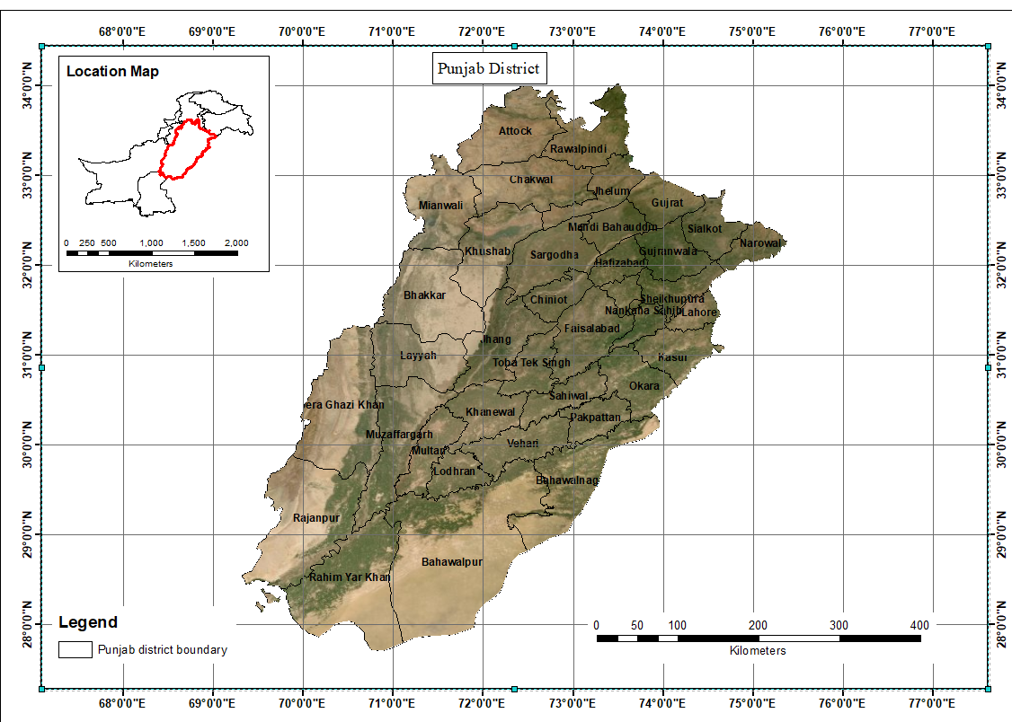
Study Area:
The name Punjab means “five waters,” or “five rivers,” and signifies the land drained by the Jhelum, Chenab, Ravi, Beas, and Sutlej rivers, which are tributaries of the Indus River.
It is situated in the 31°N 72°E (latitude and longitude) cordinates
It is Pakistan’s most populous province, with an estimated population of 110,012,442 approximately as of 2017 and the total area it covers is 205,344 km²
There is considerable rural-to-urban migration in the province, especially to the larger cities
It is bordered by the Pakistani provinces of Sindh, Baluchistan, and Khyber Pakhtunkhwa, the enclave of Islamabad, and Azad Kashmir
It lies on the margin of the monsoon climate. The temperature is generally hot, with marked variations between summer and winter
The capital is Lahore, a cultural, historical, economic and cosmopolitan Centre of Pakistan is located in the east-central region, near the border with India’s Punjab
It Pakistan's most industrialized province with the industrial sector making up 24% of the province's gross domestic product.

Slide 8
Methodology
Data Collection
We are going to deal with spatiotemporal data which is going to be collected from archives.
For different parameters we are going to use data products from different satellite for example MOD11A2.006 Terra and Aqua Land Surface Temperature and Emissivity 8-Day Global 1km
We would have yearly composites of data
Creation of thematic maps
After data acquisition the data is going to be used in the creation of thematic maps.
Thematic maps are going to be generated through the use of Software and online libraries(for JavaScript)
Software's like Qgis or ArcMap are going to be utilized for creation of the maps.
The open source libraries are going to be utilized to make the map interactive
Web portal design and development
The design and development would be done through utilizing CSS, HTML, JavaScript along with Bootstrap
The editors which are going to be utilized mostly are Sublime text 3,notepad and visual studio

Slide 9
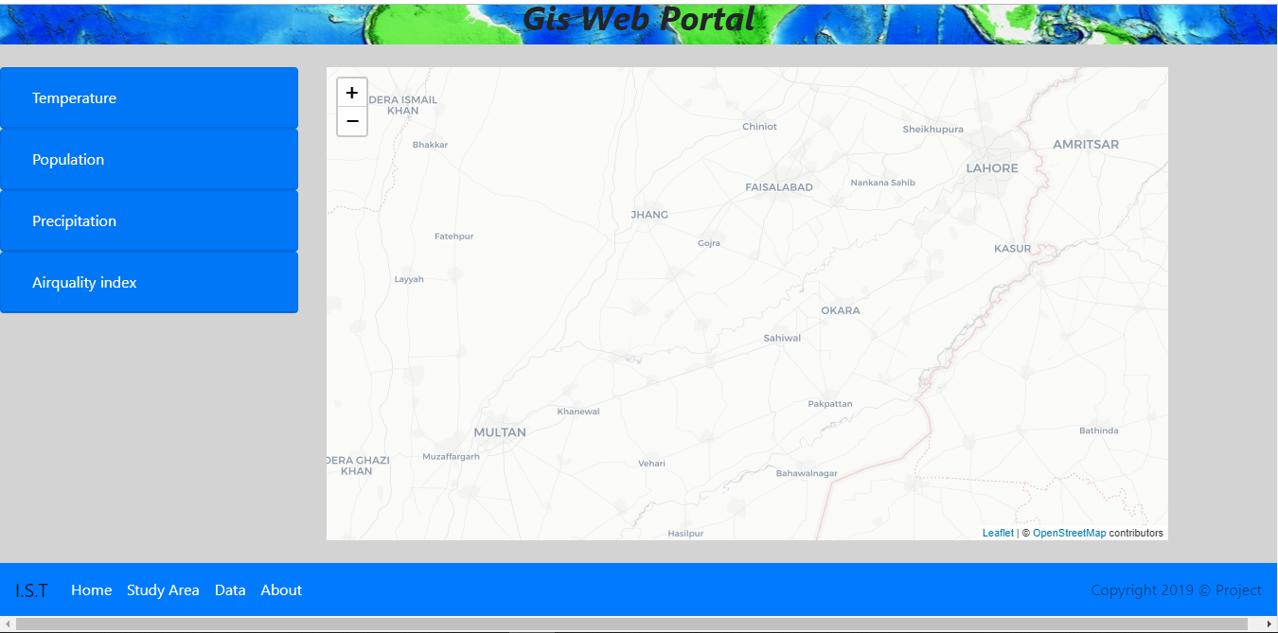
Expected Outcome:
The sample webpage is as shown in the popup.

Slide 10
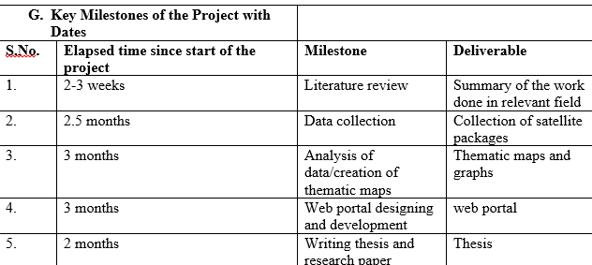
Project TimeLine

Slide 11
References for Figures
https://en.wikipedia.org/wiki/Client%E2%80%93server_model#/media/File:Client-server-model.svg
Rahman, Alias Abdul, Georg Held and Siyka Zlatanova. “Web 3D GIS for urban environments.” (2006).

Slide 12
Literature Review
Features | Methodologies | Relation to our project
A web based android application for data acquisition | Open source programs | Our goal is for the creation of a web based application in the form of a web portal rather than an android application
This application assists the quick creation of landslide inventory maps (LIMs) | Through the collection of information on the type, feature, volume, date, and patterns of landslides using open- source Web-GIS technologies such as Leaflet maps, Cordova, GeoServer, PostgreSQL as the real DBMS (database management system), and PostGIS As its plug-in for spatial database management. | The creation of thematic maps would be done using the software like Qgis or ArcMap. Then they would be visualized using geoserver and OpenLayers.
The feature information would be recorded and stored in a specific format | The specific format would be GeoJson | We are aiming to do the same for now.
An offline–online Web-GIS Android application for Fast data acquisition of landslide hazard and risk
Roya Olyazadeh1, Karen Sudmeier-Rieux1, Michel Jaboyedoff1, Marc-Henri Derron1, and Sanjaya Devkota2
University of Lausanne, ISTE – Institut des Sciences de la Terre, Faculté des géosciences et de l’environnement, Lausanne, Switzerland.
Department of Civil Engineering, Institute of Engineering, Tribhuvan University, Kathmandu, Nepal
Reference:
https://www.nat-hazards-earth-syst-sci.net/17/549/2017/

Slide 13
Literature review
Features | Methodologies | Relation to our project
Development of Web Based GIS for monitoring environmental pollution in the region of Surakarta in Indonesia | Software development using technology based on Open Source (CodeIgniter, Bootstrap, OpenLayers, and GML) | We aim to develop a Web based GIS portal for the assessment of socio-economic, bio-physical and atmospheric variables in Punjab using HTML, Bootstrap, Java and Geoserver along with arc map or Qgis
The web application was built using Rapid Application Development (RAD) | RAD is a software development method that was invented to compress the time to design and to implement information systems, so it can produce a very short development cycle. | Our application would utilize the waterfall model for the software development.
Spatial-data processing and display | Quantum GIS Valmiera, for spatial data processing and OpenLayers for data display | We would focus more on data access and visualization(presentation) for which we would use ArcMap or Qgis(for creation of maps), OpenLayers(maybe) for data visualization
The design of the main page (interface) includes spatial and non-spatial representations, menu, navigation tools, and geographic analysis. It is generally divided into 8 main parts, namely: (1) header, footer, and application title, (2) main menu, (3) legend, (4) map navigation menu (map tools), (5) layer control tab and data tracking, (6) control layer, (7) space for map (map space), and (8) panel for showing the coordinates of pointer | Using HTML, Bootstrap , Java-script | Our design for the main page as of yet includes a Navigation bar at the bottom of the page along with the footer. We have created three basic columns one is for the accordion, the other is for the map and then for the graph.
Environmental pollution monitoring using a Web-based GIS in Surakarta
Alif Noor Anna, Rudiyanto and Vidya Nahdhiyatul Fikriyah
Centre of Environmental Studies, Universitas Muhammadiyah Surakarta, Indonesia
Faculty of Geography, Universitas Muhammadiyah Surakarta, Indonesia
Reference
https://iopscience.iop.org/article/10.1088/1755-1315/314/1/012066

Slide 14
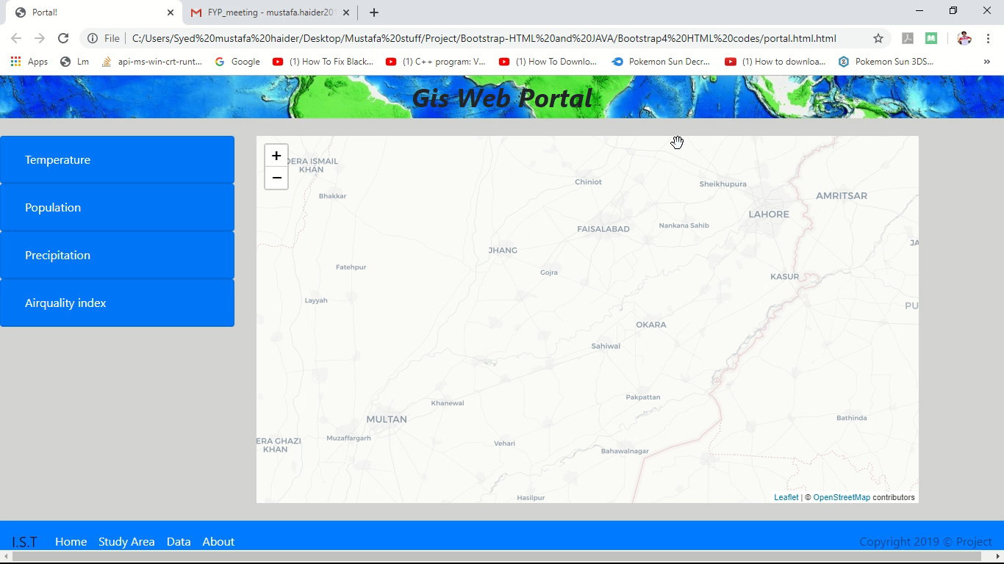
Expected Outcome

Slide 15
About the data:
Information about the data would be given in this section.

Slide 16
Methodology
Data Collection
Creation of thematic maps
Web portal design and development
The design and development would be done through utilizing CSS, HTML, JavaScript along with Bootstrap 4.00

Slide 17
Methodological Framework
Literature Review
Data collection
Creation of thematic maps
Web portal design and development
Thesis

Slide 18
Introduction to the project:
The Geospatial Web application would be used for the data access, analysis and visualization of the following Variables of the study area.
Population
Precipitation
Land surface temperature
Air pollution
The Data regarding these variables would be temporal and would be downloaded from websites like Nasa appears in the form of satellite packages.
The complied data would be represented in the form of Spatial (thematic) maps

Slide 19

Why do this Project?

